Slide 1
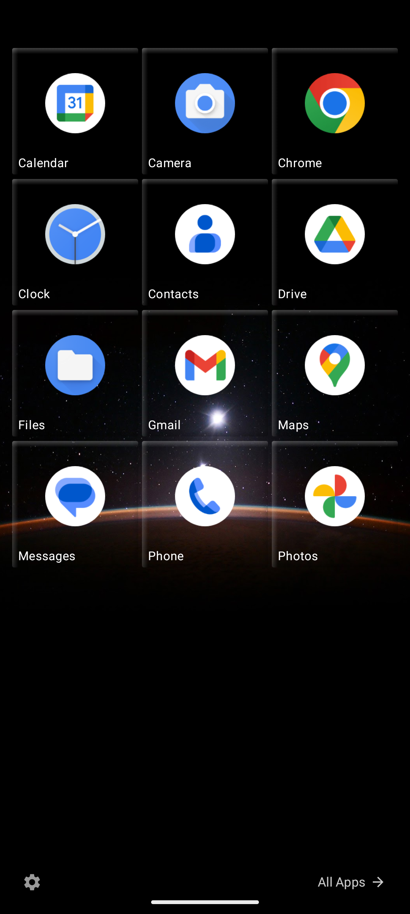
CASE STUDY
My Launcher
How the app was created
Jetpack Compose launcher inspired by Windows Phone Metro UI
Compose
Hilt
DataStore
Launcher
Alpha build for Android 10+ with a 6-column tile grid, edit mode, app list, and customization screens.
Start screen preview from the running app
Notes:
Open with the core story: the deck explains how the launcher was planned from the PRD, built in Compose, and validated on an Android emulator. Emphasize that the app targets a Windows Phone-style experience rather than a generic Android home screen.

Slide 2
PROBLEM AND MOTIVATION
Why this app exists
The idea came from a gap in the Android launcher market.
The gap
Product intent
- Windows Phone Metro UI is still distinctive and remembered fondly.
- Most Android launchers copy the same icon-grid pattern.
- Existing Metro-style launchers are usually abandoned or inaccurate.
- A home-screen replacement registered as HOME + LAUNCHER.
- A vertically scrolling 6-column Start screen with resizable tiles.
- An alphabetical app list with search and pin-to-start flows.
- A settings surface for accent color, glass bevel, and opacity.
- A path toward live tiles, persistence, and future widget integration.
The goal
- Build a launcher that feels faithful, modern, and maintainable.
- Support real customization: tile size, transparency, colors, and layout.
- Use modern Android architecture instead of a one-off UI demo.
2
Notes:
Frame the product as a response to a real UX gap. The PRD described former Windows Phone users, customization enthusiasts, and minimalist users as the target audience. The implementation was designed to satisfy all three with a clean launcher that still behaves like Android.

Slide 3
IMPLEMENTATION PATH
From PRD to alpha
The build sequence was intentionally narrow: define the core experience first, then polish it.
1
Translate the PRD into a small alpha scope
Focus on the Start screen, app list, edit mode, and settings.
2
Choose a modern stack
Kotlin, Jetpack Compose, Hilt, DataStore, Room, and Gradle Kotlin DSL.
3
Build the launcher shell
Register the activity as HOME + LAUNCHER and add edge-to-edge layout.
4
Implement the tile engine
Layout tiles on a 6-column grid with resize and drag behavior.
5
Validate on-device
Install to an emulator, inspect screenshots, and iterate on spacing and behavior.
Alpha scope
The first release focused on a believable launcher loop instead of every Metro feature from the PRD.
3
Notes:
Explain that the first version was intentionally scoped to the highest-value launcher behaviors. The alpha build proves the shell, tile grid, app discovery, settings, and edit loop before expanding into live content or sync features.

Slide 4
DATA FLOW AND CONTROL SURFACES
Architecture
The app is organized around a simple flow: discover apps, store tile state, and render it in Compose.
Installed apps
Repositories
ViewModel
Compose UI
PackageManager / LauncherApps
App discovery and tile data
Single source of state
Start screen, list, settings
User actions
Persistence
Tap, long-press, drag, resize, theme changes, and group edits all feed back into the ViewModel.
Room is declared for tile storage while DataStore handles preferences such as theme and transparency.
Manifest and platform integration
The activity is registered as both MAIN/LAUNCHER and MAIN/HOME, which is what turns the app into a real home-screen replacement.
4
Notes:
This is the technical core slide. The launcher works because app discovery, state management, persistence, and Compose rendering are kept in separate layers. Emphasize that the activity is registered as a home app, not just a normal screen in a normal app.

Slide 5
BUILD SYSTEM AND DEPENDENCIES
Stack and tooling
The implementation uses current Android tooling, but stays conservative where stability matters.
UI layer
State and data
Build and release
- Kotlin + Jetpack Compose
- Navigation Compose and activity-compose
- Compose animations for tile transitions and press tilt
- Material 3 for the settings surface
- Hilt for dependency injection
- DataStore preferences for user settings
- Room for tile layout persistence
- Repository pattern for app discovery and launch data
- Gradle Kotlin DSL with version catalogs
- Android Studio JBR for builds and installs
- Min SDK 29, target SDK 35
- Debug installs via installDebug on emulator
Why this stack fits the app
- Compose makes the custom tile UI and drag/edit interactions practical.
- Hilt and repositories keep the launcher code testable as it grows.
- DataStore and Room separate small preferences from structured layout state.
5
Notes:
Call out that the stack is intentionally modern but not experimental. Compose handles the launcher UI well, while DataStore and Room keep settings and tile state separate from rendering logic. The version catalog keeps dependency management tidy.

Slide 6
METRO-STYLE HOME SHELL
Start screen
This is the main home screen: a six-column tile grid with drag-and-drop behavior.
Grid behavior
Tiles can span 1 to 6 columns wide and 1 to 4 rows tall, which keeps the layout flexible while preserving the Metro rhythm.
Interaction
Long-press enters edit mode; dragging automatically displaces overlapping tiles to the nearest free space.
Visual treatment
Wallpaper shows through transparent tiles, and the UI uses large type, dark surfaces, and subtle glass bevels.
Start screen loop
This screen is the reason the app feels like a launcher instead of a standard list-based application.
6
Notes:
Use the screenshot to show the actual result of the tile grid implementation. Mention that the UI is designed around a six-column grid, with the wallpaper visible through translucent tiles and a start screen layout that mirrors Windows Phone.

Slide 7
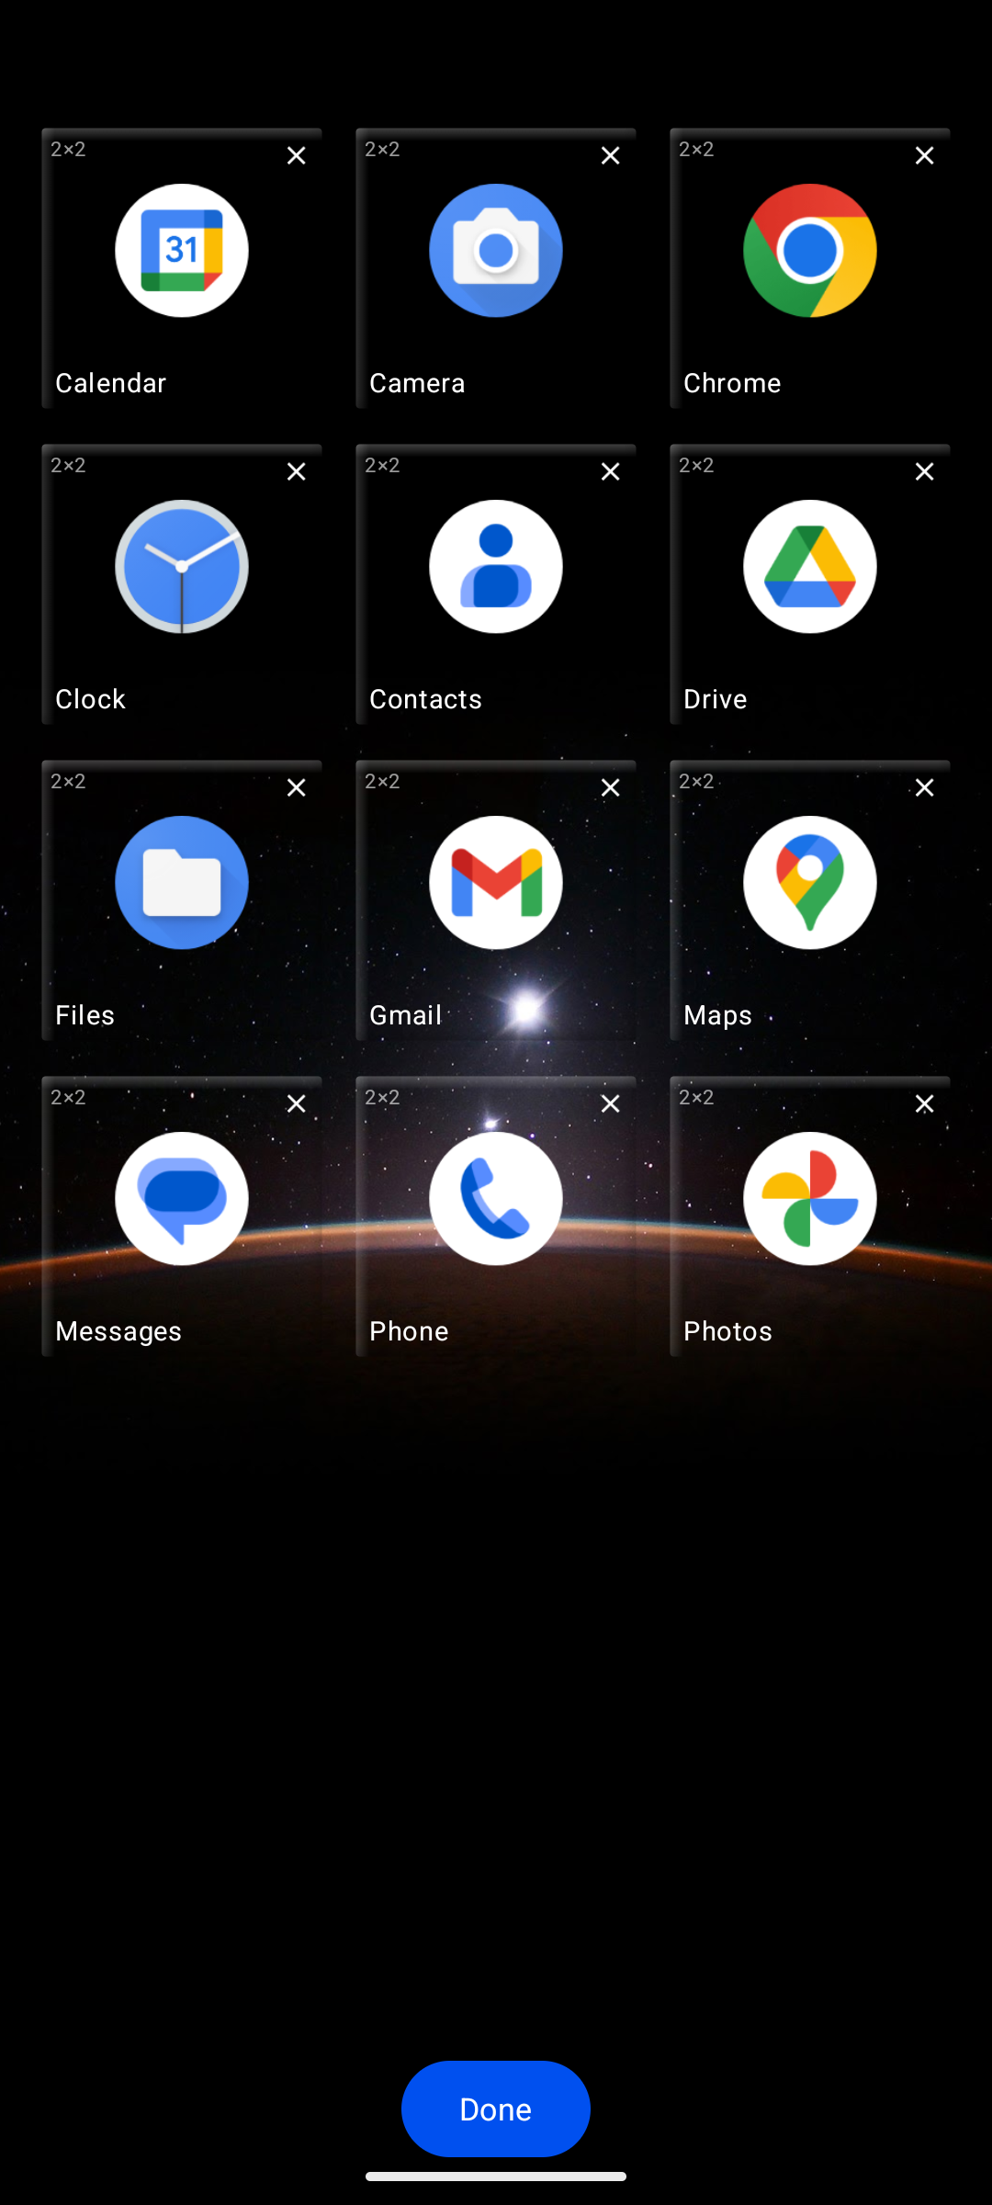
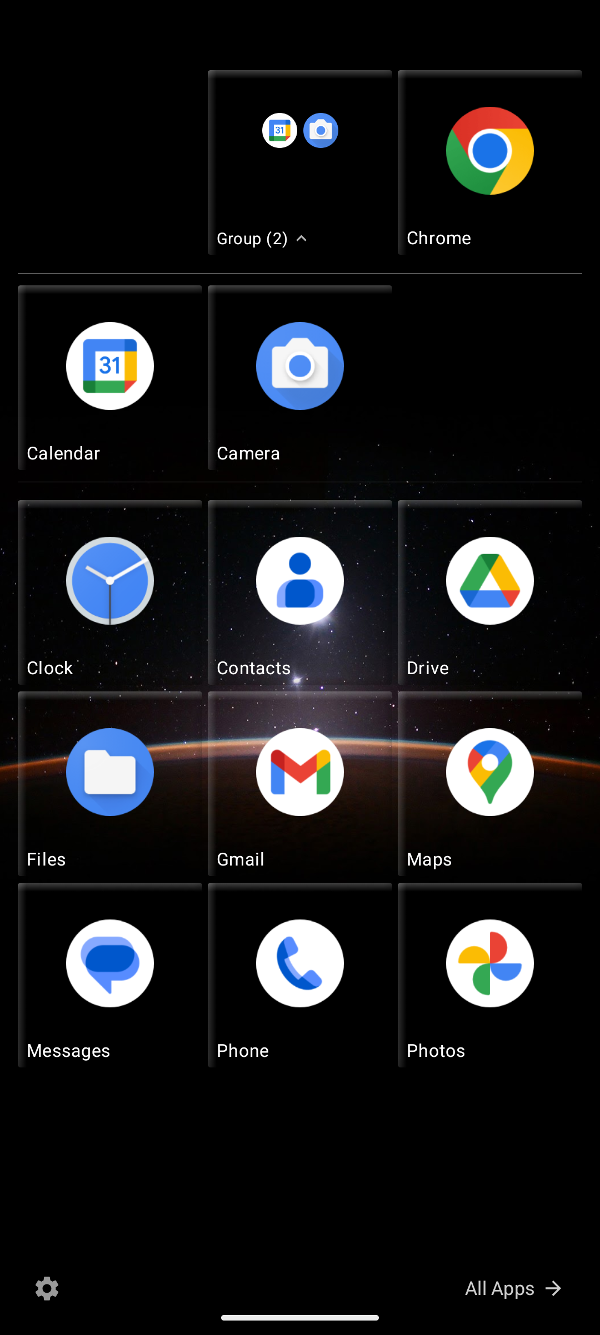
TILE MANAGEMENT
Edit mode and groups
The tile system supports resizing, unpinning, and dwell-to-group interactions.
Edit mode
Long-press a tile to shrink it, show its size label, and expose the unpin button.
Grouping
Dragging onto another tile and holding still creates a group; expanded groups can be rearranged and ungrouped.
7
Notes:
This slide explains the more distinctive launcher behavior. Edit mode exposes the controls that make the layout personal, while dwell-to-group is the main interaction that differentiates the app from a standard icon grid.

Slide 8
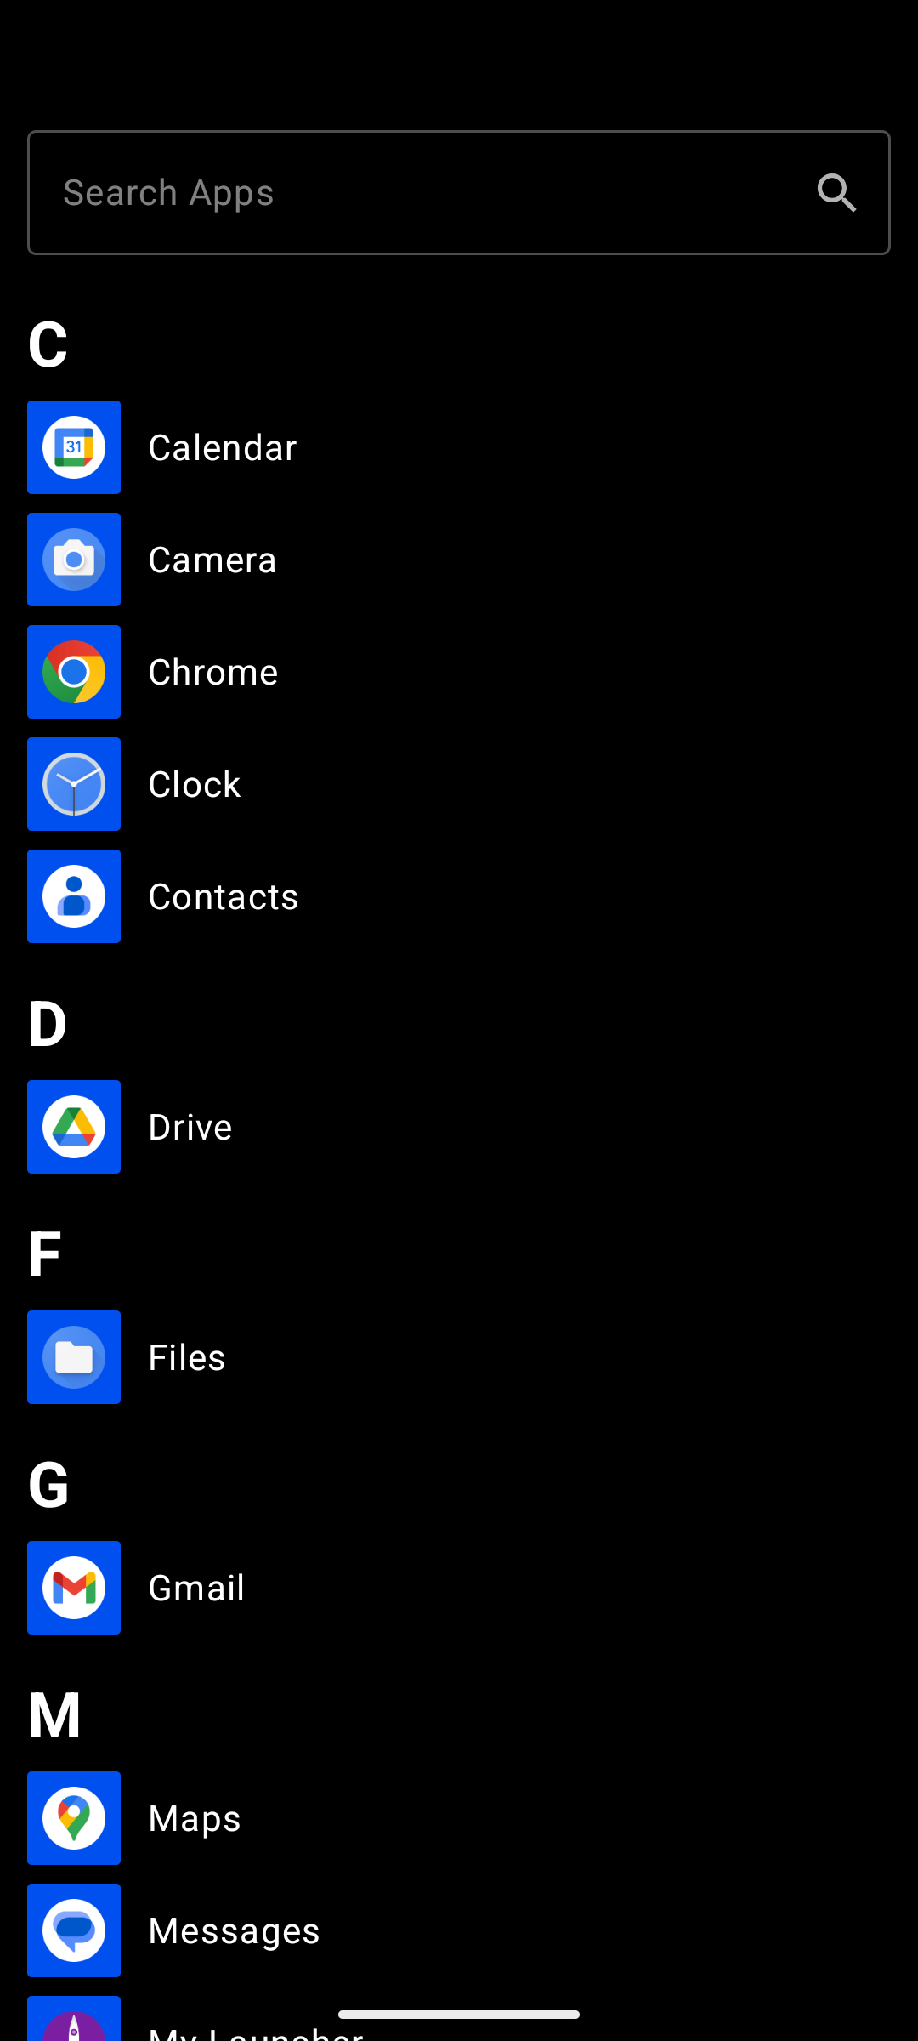
NAVIGATION AND DISCOVERY
App list and search
The second screen gives fast discovery and a clean pin-to-start workflow.
Navigation model
- Swipe right from Start, or tap All Apps at the bottom-right.
- The app list uses alphabetical headers and a search bar at the top.
Pinning flow
- Long-press any app to pin it back to the Start screen as a tile.
- This keeps the launcher tied to the installed app set on the device.
Visual pattern
- Accent-colored square icon blocks echo the Windows Phone app list.
- The layout is intentionally dense and text-forward.
8
Notes:
Explain that the app list is not a separate launcher, but the second half of the same navigation model. It supports quick search, section headers, and a long-press pin action that feeds the Start screen.

Slide 9
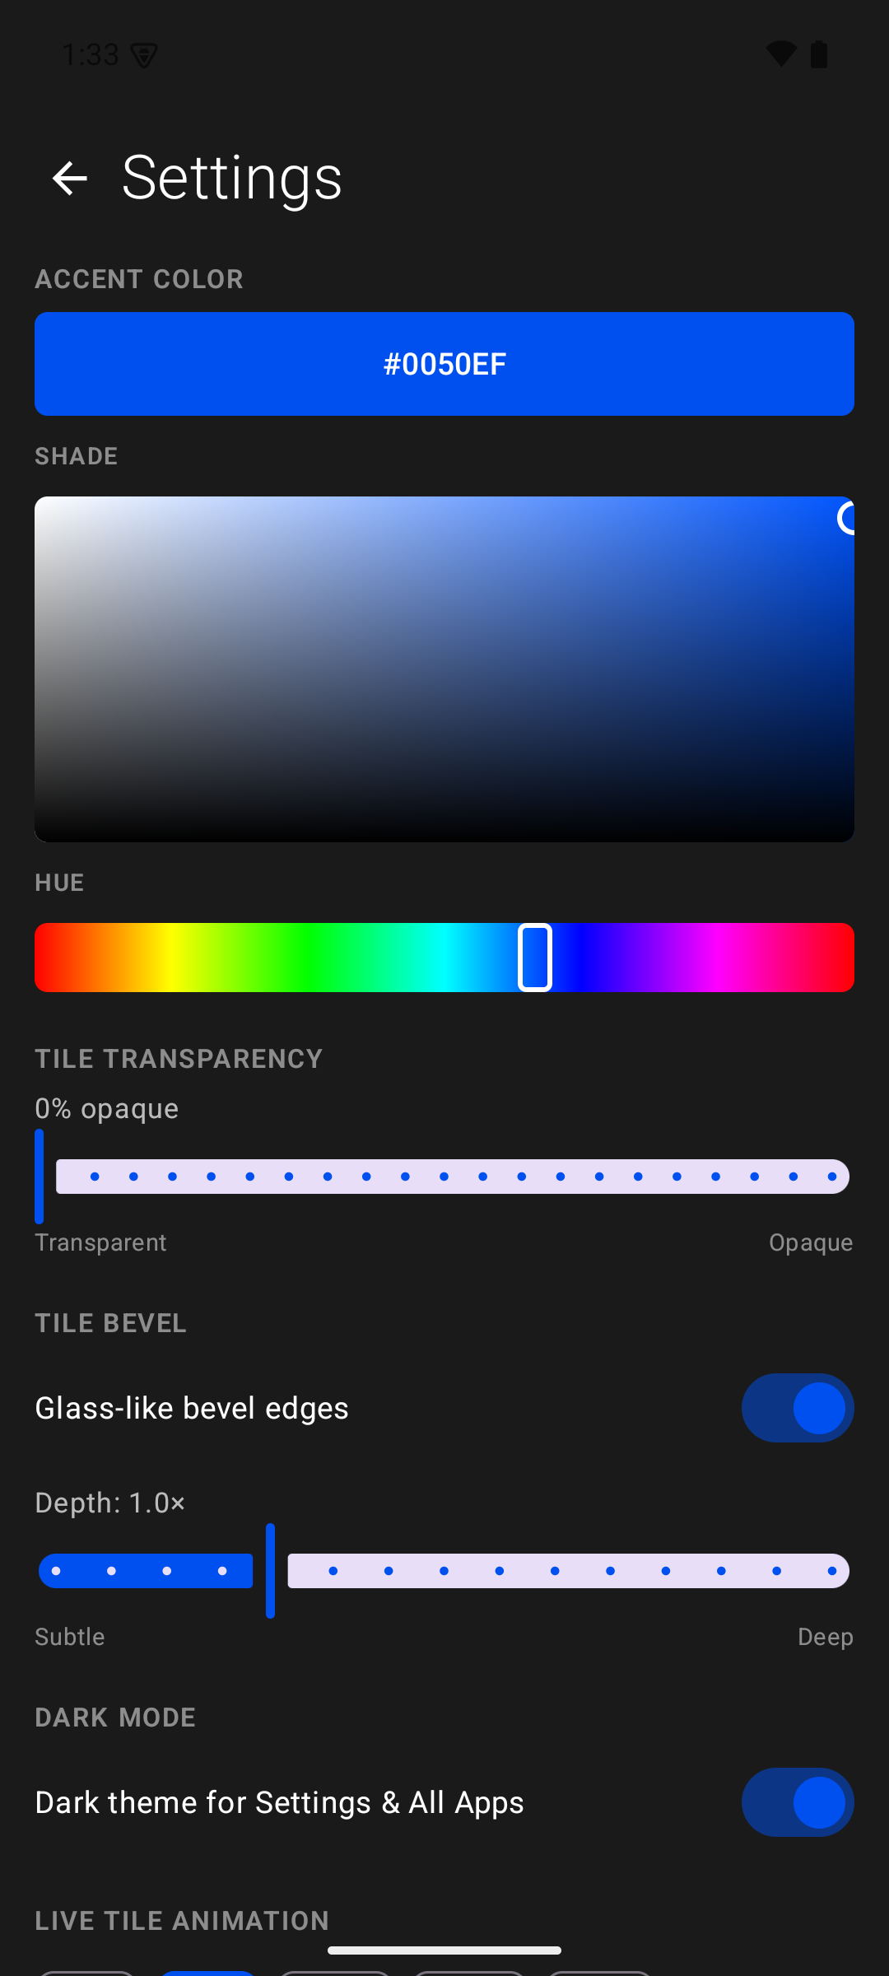
VISUAL CUSTOMIZATION
Settings and theming
The customization surface makes the launcher feel personal instead of fixed.
Accent color
- HSV picker with live hex preview and a Metro-style blue default.
Transparency and bevel
- Global tile opacity slider plus a glass-like bevel depth control.
Theme and interval
- Dark/light mode, live-tile animation interval, and theme saving.
Why settings matter
- The UI design only works if users can shape the look and density of the screen.
9
Notes:
Show the settings screen as the control center for the app. The important detail is that the launcher is highly themeable, so the same core UI can support different tastes and levels of transparency.

Slide 10
DEVELOPMENT WORKFLOW
Build and validation loop
The app was created by building, installing, and checking the result on a live emulator.
Gradle
Emulator
adb install
Launch
Inspect
Environment
Validation
Documentation
Android Studio JBR supplies the JDK, while the local Android SDK provides emulator and platform-tools.
The debug build is installed with installDebug, then the launcher is opened directly on the device.
Screenshots and release notes in docs/ capture the state of the app and the roadmap after each milestone.
10
Notes:
This is the engineering loop slide. The project was validated by building to a running emulator, launching the home activity, and comparing the result to the documented UI. That keeps the deck grounded in an actual implementation path rather than a slide-only concept.

Slide 11
STATUS AND NEXT STEPS
Where it stands now
The alpha is a working launcher shell with a clear path for the next features.
What is in place
What is still evolving
Takeaway
- Working home-screen replacement
- Start screen tile grid and app list
- Edit mode, drag and drop, and groups
- Accent color and transparency settings
- Metro-inspired visual language
- Persistent tile storage refinement
- True live tile data sources
- Notification badges
- Backup and restore polish
- Widget and richer integration work
- The project is already a usable launcher.
- The remaining work is about fidelity, data, and scale.
- The architecture leaves room for those additions without a rewrite.
Result: a modern Android launcher that recreates the Windows Phone feel while staying maintainable in Kotlin and Compose.
11
Notes:
Close with the current state of the app. The alpha already demonstrates the key user experience, and the remaining roadmap is about making the launcher richer and more durable over time.

